Slide 1


PHP Programming course
MEC Academy

Slide 2
Agenda
Cookie
Session
Login form
Handling file upload
Dependencies
&
Issues / Risks
Schedule (High Level)
Completed Activities
Timeline
Action
Items
Change Requests

Slide 3
PHP Cookie
PHP cookie is a small piece of information which is stored at client browser. It is used to recognize the user.
Cookie is created at server side and saved to client browser. Each time when client sends request to the server, cookie is embedded with request. Such way, cookie can be received at the server side.

Slide 4
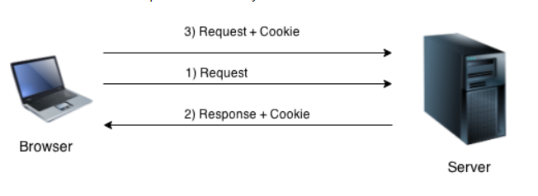
PHP Cookie
Note: PHP Cookie must be used before <html> tag.

Slide 5
PHP Cookie
Create Cookie : setcookie() function is used to set cookie with HTTP response.
Get Cookie : $_COOKIE superglobal variable is used to get cookie. Once cookie is set, you can access it by $_COOKIE superglobal variable
Delete Cookie : If you set the expiration date in past, cookie will be deleted.

Slide 6
PHP Cookie syntax
bool setcookie
(
string $name ,
string $value ,
int $expire ,
string $path ,
string $domain ,
bool $secure ,
bool $httponly
)

Slide 7
PHP Session
PHP session is used to store and pass information from one page to another temporarily (until user close the website).
PHP session technique is widely used in shopping websites where we need to store and pass cart information e.g. username, product code, product name, product price etc from one page to another.
PHP session creates unique user id for each browser to recognize the user and avoid conflict between multiple browsers.

Slide 8
PHP Session
session_start() function is used to start the session. It returns existing session if session is created already. If session is not available, it creates and returns new session
$_SESSION is an associative array that contains all session variables. It is used to set and get session variable values.
session_destroy() function is used to destroy all session variables completely.

Slide 9
Login form
We can create and use forms in PHP. To get form data, we need to use PHP superglobals $_GET and $_POST.
The form request may be get or post. To retrieve data from get request, we need to use $_GET, for post request $_POST.

Slide 10
Login form
PHP Get Form
Get request is the default form request. The data passed through get request is visible on the URL browser so it is not secured. You can send limited amount of data through get request.
PHP Post Form
Post request is widely used to submit form that have large amount of data such as file upload, image upload, login form, registration form etc.
The data passed through post request is not visible on the URL browser so it is secured. You can send large amount of data through post request.

Slide 11
PHP File Handling
PHP File System allows us to create file, read file line by line, read file character by character, write file, append file, delete file and close file.

Slide 12
PHP File Handling
PHP Open File - fopen()
The PHP fopen() function is used to open a file.
PHP Close File - fclose()
The PHP fclose() function is used to close an open file pointer.
PHP Read File - fread()
The PHP fread() function is used to read the content of the file.
PHP Write File - fwrite()
The PHP fwrite() function is used to write content of the string into file.
PHP Delete File - unlink()
The PHP unlink() function is used to delete file.

Slide 13
PHP File Handling
resource fopen ( string $filename , string $mode );
fclose ( resource $handle )
string fread ( resource $handle , int $length )
int fwrite ( resource $handle , string $string [, int $length ] )
bool unlink ( string $filename [, resource $context ] )

Slide 14
Handling file upload
PHP allows you to upload single and multiple files through few lines of code only.
The PHP global $_FILES contains all the information of file. By the help of $_FILES global, we can get file name, file type, file size, temp file name and errors associated with file.

Slide 15
Handling file upload
$_FILES['filename']['name']
returns file name.
$_FILES['filename']['type']
returns MIME type of the file.
$_FILES['filename']['size']
returns size of the file (in bytes).
$_FILES['filename']['tmp_name']
returns temporary file name of the file which was stored on the server.
$_FILES['filename']['error']
returns error code associated with this file.

Slide 16
move_uploaded_file() function
The move_uploaded_file() function moves the uploaded file to a new location.
The move_uploaded_file() function checks internally if the file is uploaded thorough the POST request. It moves the file if it is uploaded through the POST request.

Slide 17
move_uploaded_file() function
bool move_uploaded_file ( string $filename , string $destination )

Slide 18
ASSIGNMENT
make login form with name , password, email and phone number then display all user input using submit button.

